Slide 1

DATA COMMUNICATION · CMP-335
Quadrature Amplitude
Modulation (QAM)
Suraj k. Jha
Roll No. 231537 · B.E. IT, 6th Semester
01

Slide 2
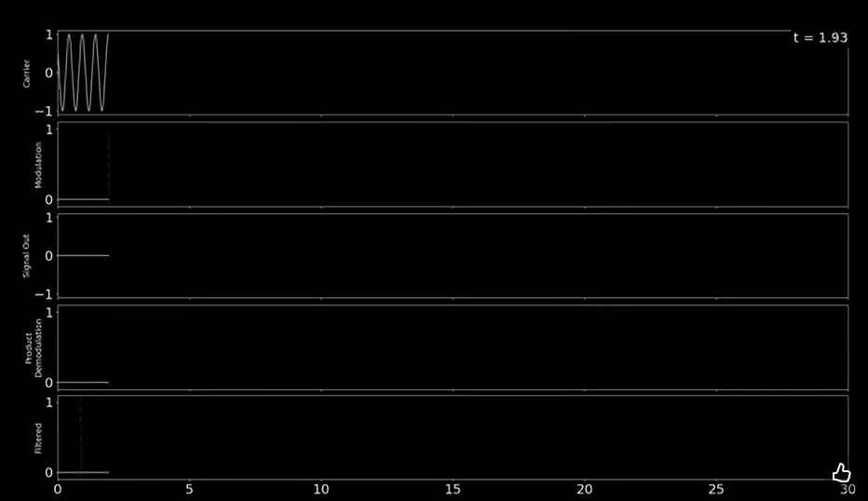

Slide 3
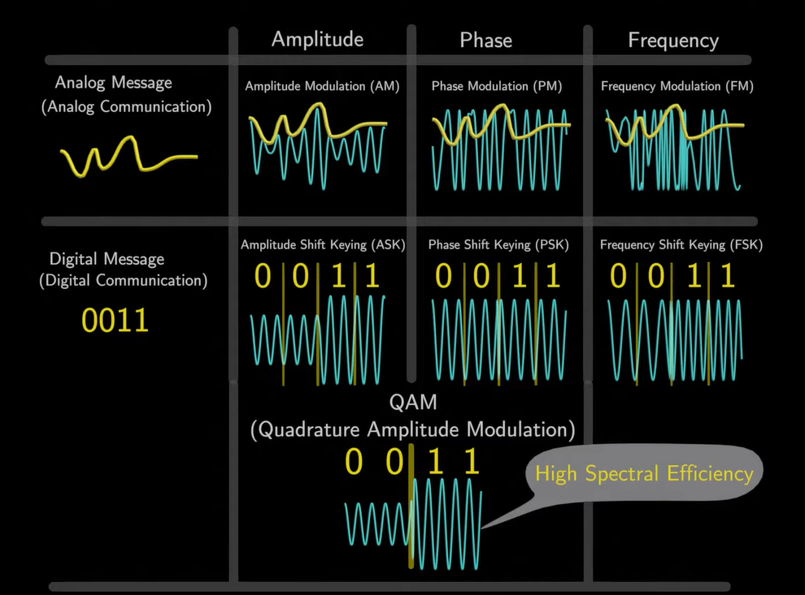

Slide 4
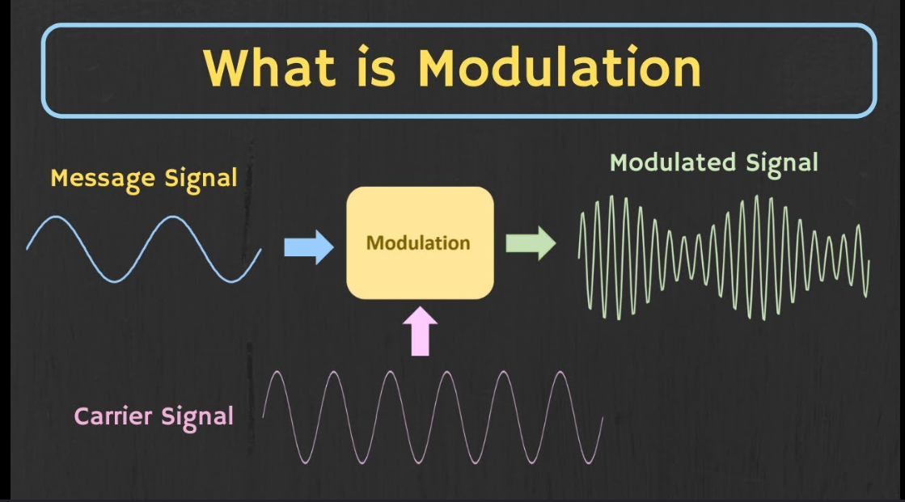
01 · FOUNDATIONS
Modulation
Modulation is the process of modifying a carrier wave using a message signal to enable efficient transmission of information over a communication channel.
Why it matters
Baseband signals travel poorly over long distances — modulation shifts them onto a carrier suited to the channel.
Carrier, message, and resulting modulated waveform
02

Slide 5
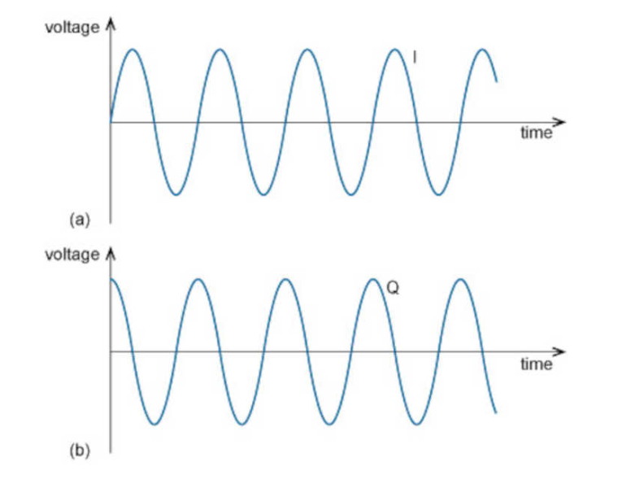
Quadrature
Quadrature is the condition where two signals of the same frequency are 90° out of phase with each other.
90°
I & Q
In-phase and Quadrature
components carried independently
phase offset between
the two carriers
Two carriers, same frequency, 90° apart
03

Slide 6
02 · THE SCHEME
Quadrature Amplitude Modulation
QAM is a modulation scheme in which two carrier signals of the same frequency, separated by 90° in phase, are independently amplitude-modulated and combined to transmit information with high spectral efficiency.
IQ
+
↑
Two orthogonal carriers
ASK + PSK combined
High efficiency
Uses two carrier signals: In-phase (I) and Quadrature (Q), modulated independently.
Combines the principles of Amplitude Shift Keying (ASK) and Phase Shift Keying (PSK).
Provides high data rates and better bandwidth efficiency than simpler schemes.
04

Slide 7
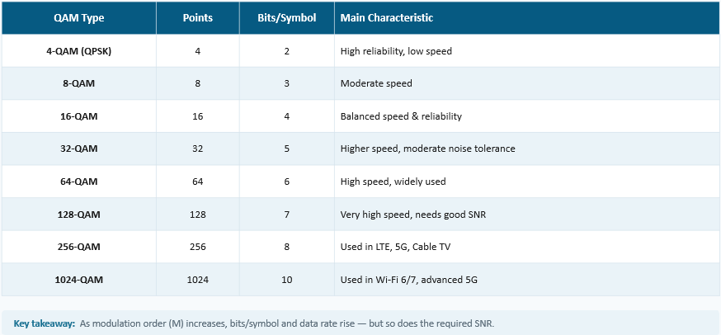
QAM Modulation Types
Higher-order QAM packs more bits per symbol at the cost of noise margin.
05

Slide 8
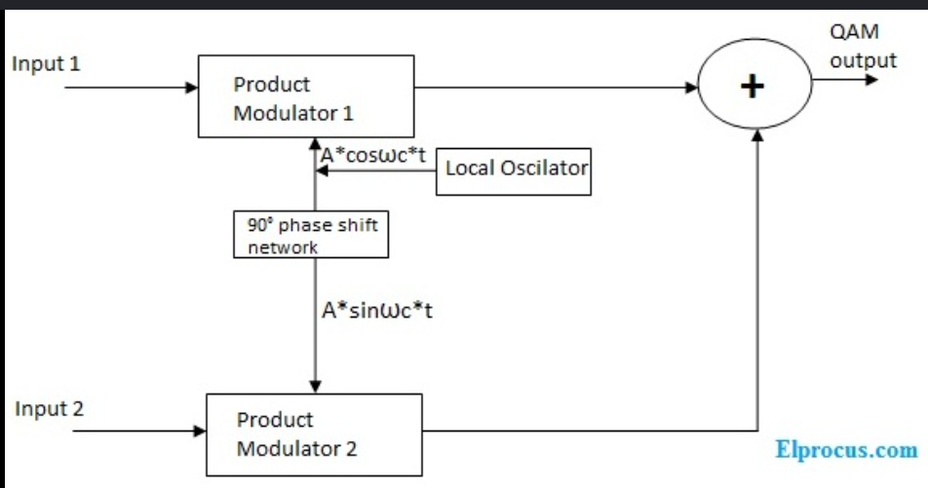
03 · SYSTEM BLOCKS
QAM Modulator
A QAM modulator is a circuit that generates a QAM signal by modulating two orthogonal carrier signals (I and Q) with digital data and combining them for transmission.
1
Split data into I & Q streams
2
Modulate each onto orthogonal carriers
3
Sum the two for transmission
I/Q modulation and signal-combining stages
06

Slide 9
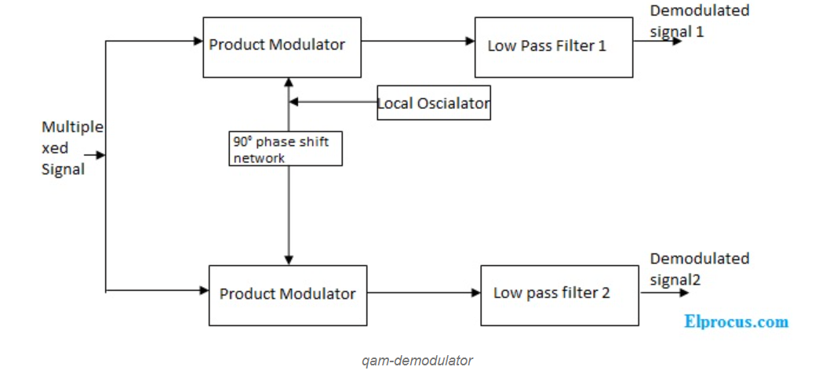
QAM Demodulator
A QAM demodulator is a circuit that extracts the original digital data from a received QAM signal by separating the I and Q components.
Mirror of the modulator
⇄
It separates I and Q using synchronized reference carriers, then recombines them into the original bitstream.
Received signal separated back into I and Q data
07

Slide 10
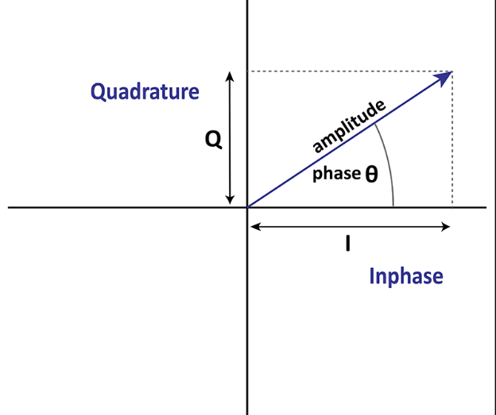
04 · ENCODING
Relationship Between Bits and Symbols
S
Symbol
A unique signal state used to represent one or more bits during transmission.
Instead of sending bits one by one, QAM groups multiple bits together and transmits them as a single symbol — multiplying effective throughput for the same symbol rate.
08

Slide 11
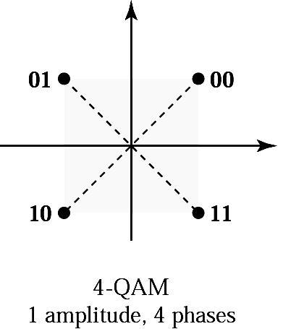
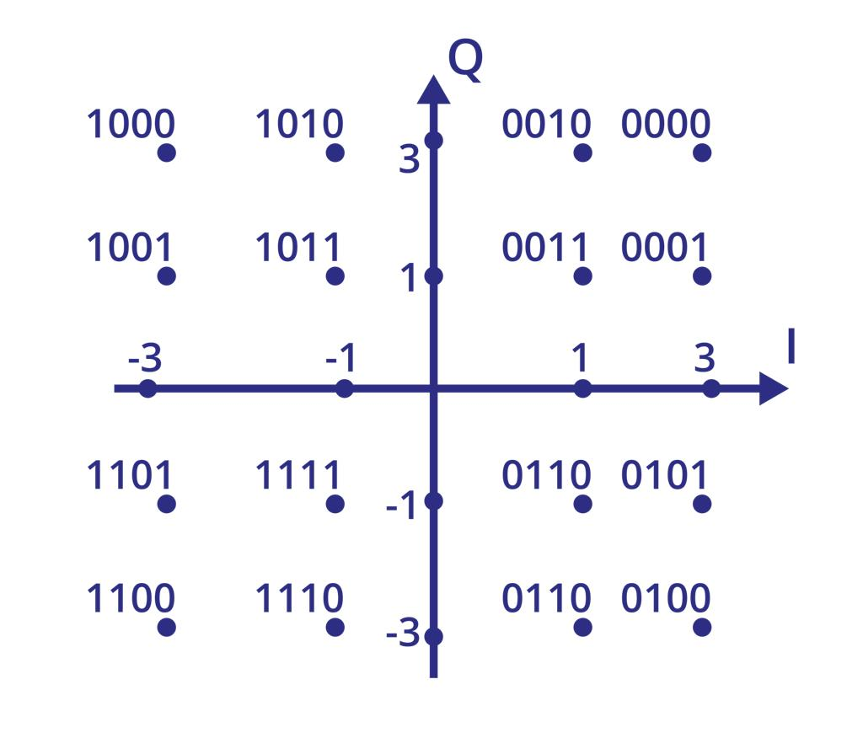
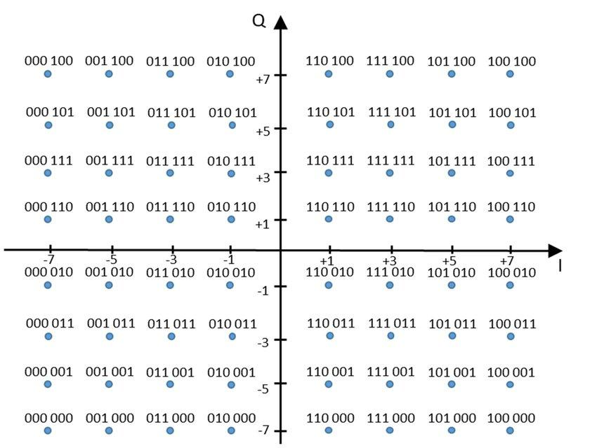
Constellation Diagram
A graphical representation of digital modulation symbols, where each point represents a unique combination of amplitude and phase.
4-QAM
16-QAM
64-QAM
09

Slide 12
Advantages of QAM
✓
High Data Rate
✓
High Bandwidth Efficiency
Transmits multiple bits per symbol, allowing faster data transmission.
Makes efficient use of available bandwidth within the same frequency range.
✓
✓
Flexible Modulation Orders
High Spectral Efficiency
More data can be transmitted per unit of bandwidth than many other schemes.
16-QAM, 64-QAM, 256-QAM and more can be selected based on channel conditions.
10

Slide 13
Disadvantages of QAM
!
Sensitive to Noise
!
Requires High SNR
Higher-order QAM signals are more easily affected by noise and interference.
Reliable communication needs a strong and clean signal-to-noise ratio.
!
Complex Design
!
Needs Precise Sync
Modulators and demodulators are more complicated than simpler schemes.
Transmitter and receiver must maintain accurate carrier frequency and phase.
11

Slide 14
05 · IN PRACTICE
Applications of Analog & Digital QAM
Analog QAM
Digital QAM
Analog color television
Wi-Fi
Microwave communication
4G LTE / 5G
Digital television
Analog radio systems
Cable TV & cable modems
Analog video transmission
Satellite communication
Broadband Internet
12

Slide 15


